Slide 1
Design of a Digital Twin-Based System for Multi-Bank Battery Monitoring, State Estimation and Fault Prediction

Slide 2
Table of Contents
01
Introduction
06
Novelty of Work
02
Objectives of the Work
07
System Design & Implementation
03
Literature Review Summary
08
Results & Discussions
04
Research Gap & Problem Statement
09
Conclusion & Future Scope
05
Proposed Methodology
10
Publications & Bibliography

Slide 3
Introduction:
Lithium-ion batteries are widely used in electric vehicles, renewable energy systems, and portable electronics
Efficient battery management is essential for improving safety, performance, and lifespan
Important battery parameters include State of Charge (SOC), State of Health (SOH), and Remaining Useful Life (RUL)
Conventional Battery Management Systems (BMS) rely on single estimation techniques and limited parameters
These systems cannot adapt effectively to changing battery conditions such as aging and temperature variations
Digital Twin technology provides a real-time virtual representation of the physical battery system
It enables continuous monitoring, prediction, and system optimization

Slide 4
Objectives of the Work
①
Develop a Digital Twin model for a multi-bank (5×30 cells) lithium-ion battery system in MATLAB/Simulink
②
Implement hybrid state estimation: AEKF, Li-Mamba, BatteryGPT, TDSPIN & Federated Ensemble
③
Estimate 22 battery health indicators: SOC, SOH, RUL, SOP, Degradation Index, Stress, Aging Rate & more
④
Validate Digital Twin by continuously comparing simulation vs. physical hardware branches in real time
⑤
Integrate IoT cloud monitoring (ThingSpeak – 4 channels × 8 fields) and Node-RED visualization dashboard
⑥
Demonstrate scalability and prepare system for hardware-in-the-loop (HIL) validation on real battery packs

Slide 5
Literature Review
Author | Method Used | Contribution | Limitation
Plett (2004) | EKF | Accurate SOC estimation | Depends on model accuracy
He et al. (2011) | EKF | Improved estimation performance | Sensitive to noise
Hu et al. (2012) | NN vs KF | Comparison study | High complexity
Severson (2019) | ML | RUL prediction | Requires large dataset
Schmidt (2019) | Cloud BMS | Remote monitoring | Latency issues
Tang (2021) | Digital Twin | Improved prediction | No real-time sync

Slide 6
Research Gap
Lack of real-time integration between simulation models and physical battery systems
Existing systems rely on single estimation algorithms leading to reduced accuracy
Limited number of parameters monitored in traditional BMS
Absence of adaptive models to handle battery aging and environmental variations
No effective integration of IoT for real-time monitoring and visualization
Lack of scalability for multi-bank battery configurations
No comparison between multiple estimation techniques in real-time

Slide 7
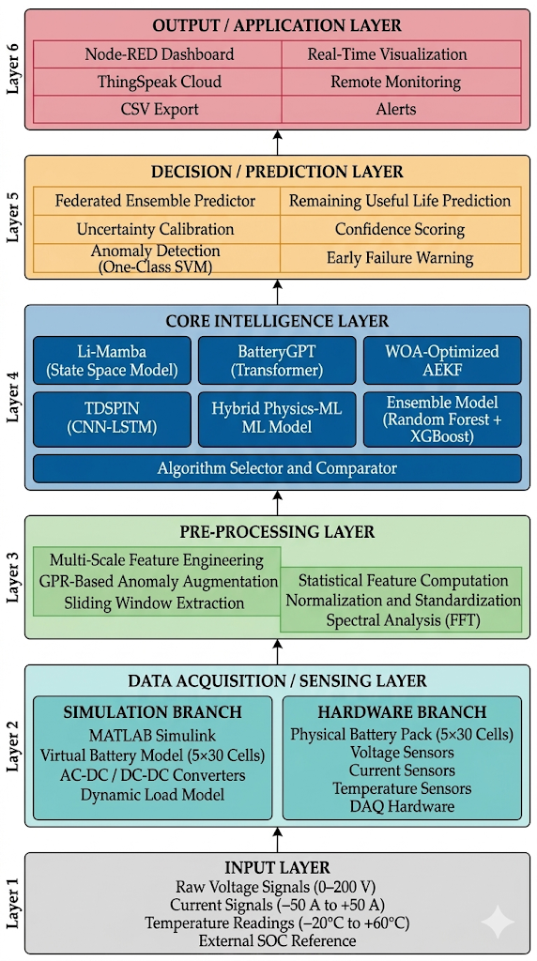
Proposed System Architecture
Layered Architecture Overview
• Data Acquisition Layer
Voltage, current, and temperature sensors monitor battery cells and collect real-time data.
• Pre-processing Layer
Signal filtering, data normalization, and feature extraction prepare battery parameters for analysis.
• Core Intelligence Layer
AI algorithms (AEKF, Li-Mamba, Battery, TDSPIN, Ensemble) estimate battery health and enable adaptive algorithm selection.
• Prediction & Safety Layer
Predicts State of Health (SOH), Remaining Useful Life (RUL), and detects faults or thermal runaway conditions.
• Output & Visualization Layer
Displays battery status and sends data to cloud dashboards with real-time alerts and monitoring.

Slide 8
Novelty of This Work
First-of-kind Li-Mamba for Batteries
Federated Ensemble + Uncertainty
Li-Mamba (State Space Model), originally designed for language processing, is applied to battery state estimation for the first time — achieving 0.65% SOC error, 2.6× faster than Transformers, 4.4× less memory.
5 algorithms (AEKF, Li-Mamba, BatteryGPT, TDSPIN, RF+XGBoost) run in parallel; a comparator selects the best in real-time. Epistemic & aleatoric uncertainty quantified with every prediction.
Parallel Sim–Hardware Digital Twin
22-Parameter Health Vector
Simulation (MATLAB/Simulink) and hardware sensor branches run simultaneously with continuous cross-comparison — the twin corrects itself in real-time, unlike offline models.
Conventional BMS tracks 5–10 parameters. This system extracts 22 indicators: SOC, SOH, RUL, SOP, Degradation Index, Aging Rate, Stress Index, Health Index, thermal metrics, and more.
96.2% Early Fault Detection
Patent Filed
GPR-based anomaly augmentation + OC-SVM detect thermal and electrical faults ~2 seconds before they become critical with 96.2% accuracy — critical for EV safety.
Invention Disclosure Form submitted for: Digital Twin-Based Battery Management System with AI-Driven Prediction and Cloud Integration — recognizing the originality of this combined approach.

Slide 9
System Workflow
Key Processing Steps
Data Acquisition: 150 cells (5 modules × 30 cells) at 100 Hz sampling
Feature Extraction: Multi-scale statistical features (396 dimensions)
AI Model Execution: Parallel execution of 5 algorithms
Safety Prediction: Thermal runway probability, fault classification
Output Generation: Real-time alerts and cloud visualization

Slide 10
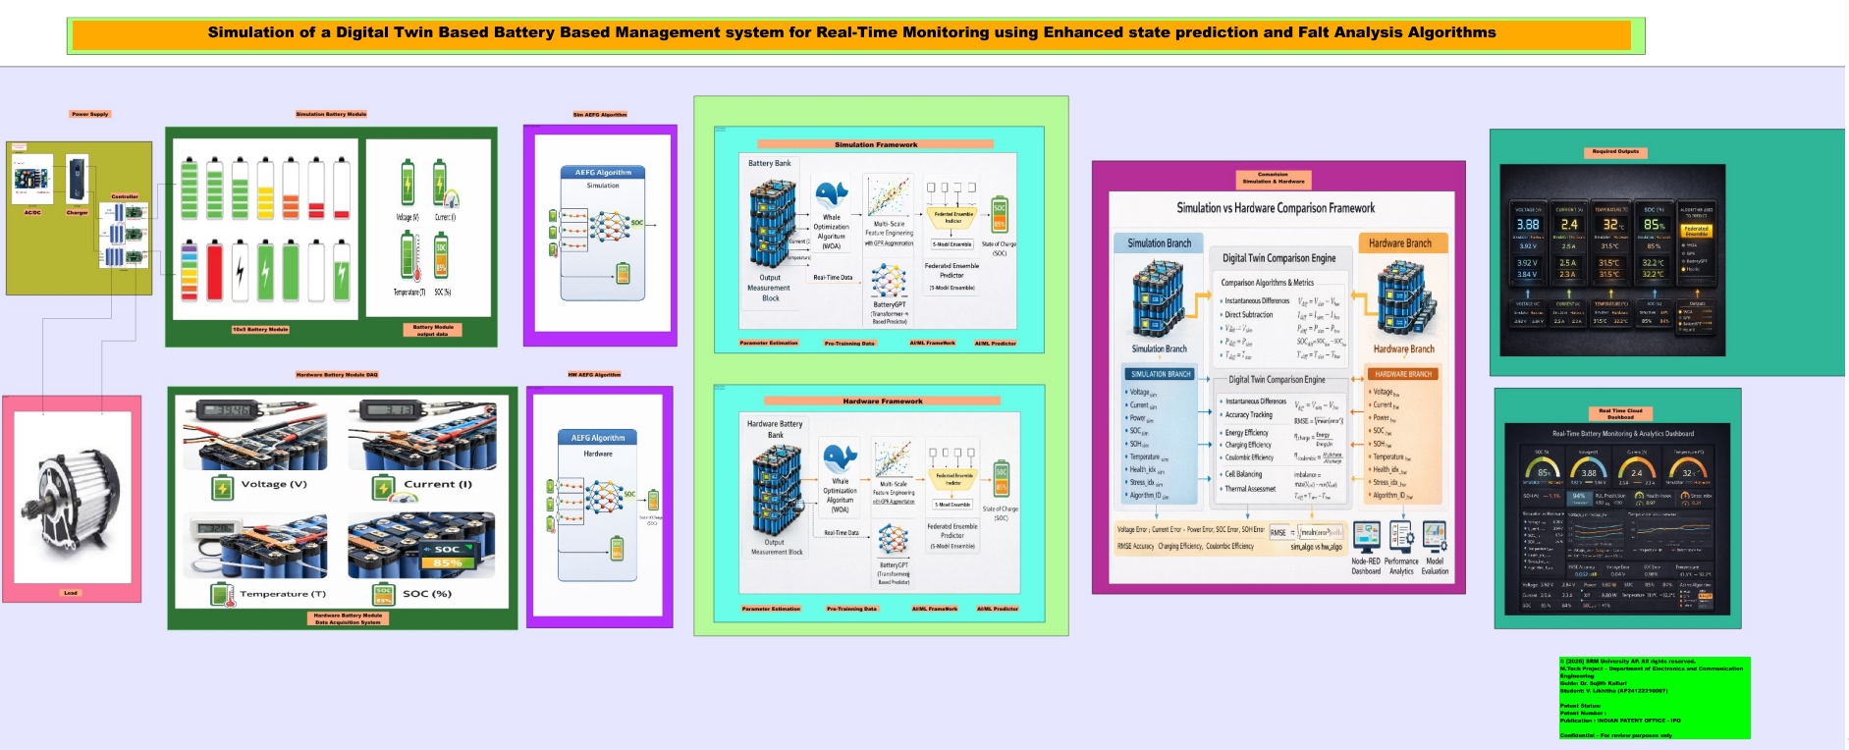
MATLAB Implementation:
Developed a MATLAB/Simulink model for EV battery health monitoring with a modular battery pack
Modeled voltage, current, and temperature for realistic battery behavior
Implemented AEKF and Li-Mamba algorithms for real-time state estimation
Applied feature extraction and AI models for SOH and RUL prediction
Integrated safety monitoring and algorithm comparison for performance evaluation
Enabled visualization and cloud communication for monitoring system outputs

Slide 11
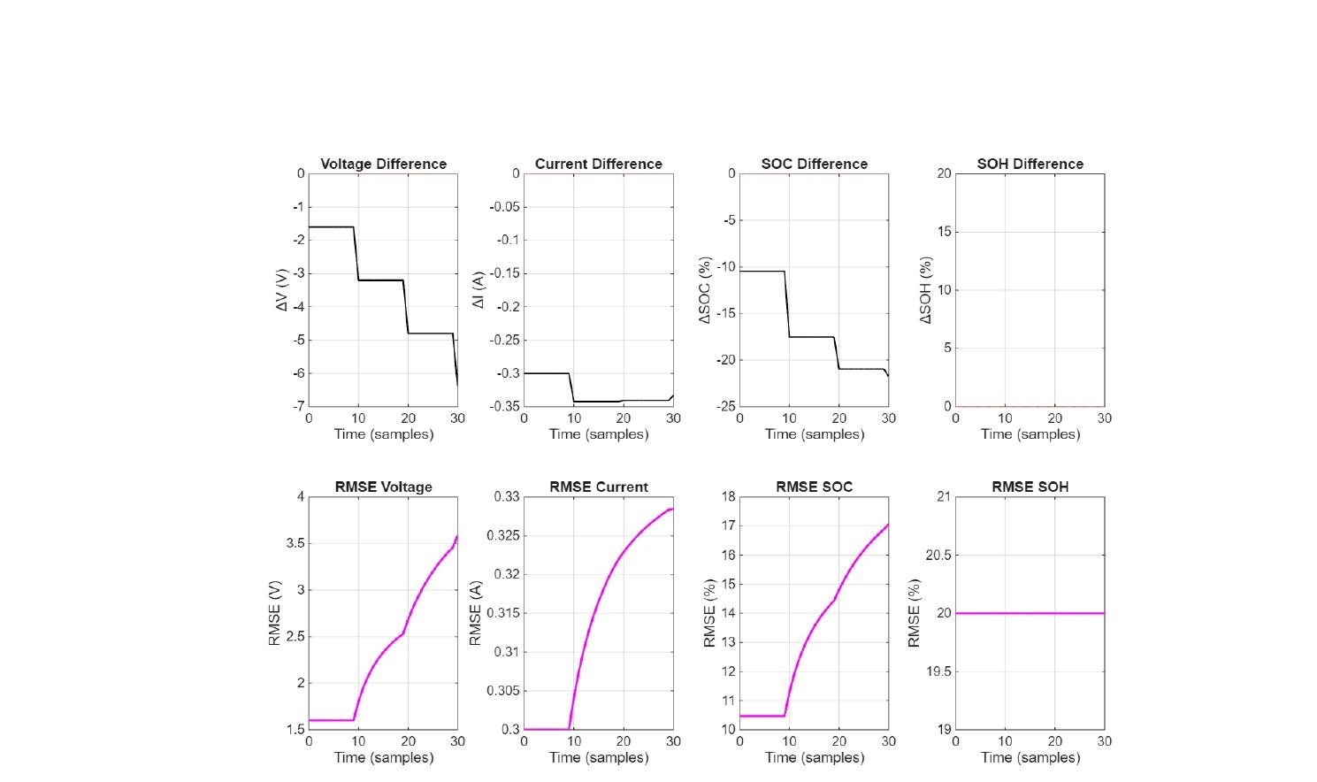
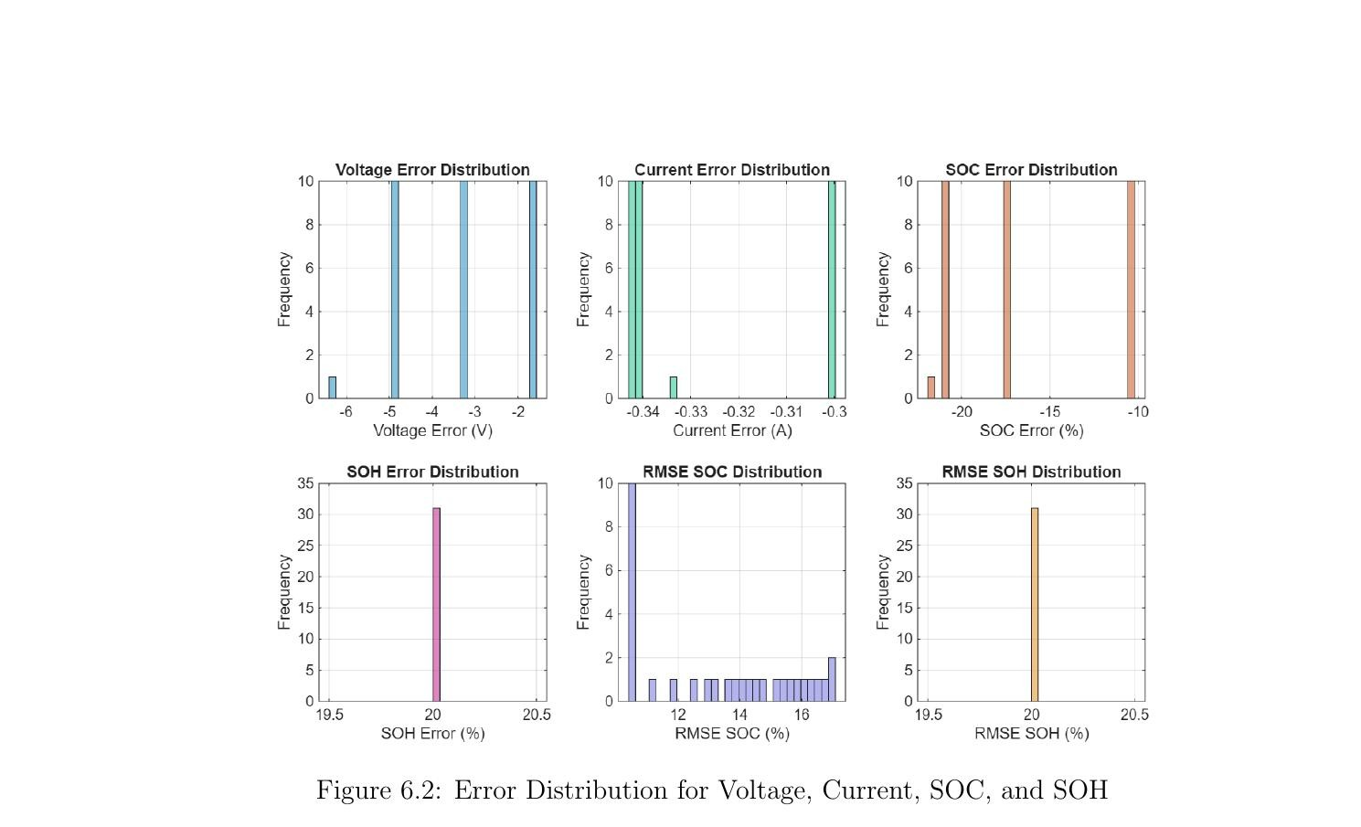
Results & Discussions – Simulation Outputs & Error Analysis
Fig : Overall Simulation Output Signals
(Voltage, Current, SOC, SOH difference + RMSE trends)
Fig : Error Distribution – Voltage, Current, SOC & SOH
(Highly clustered distributions confirm estimation precision)

Slide 12
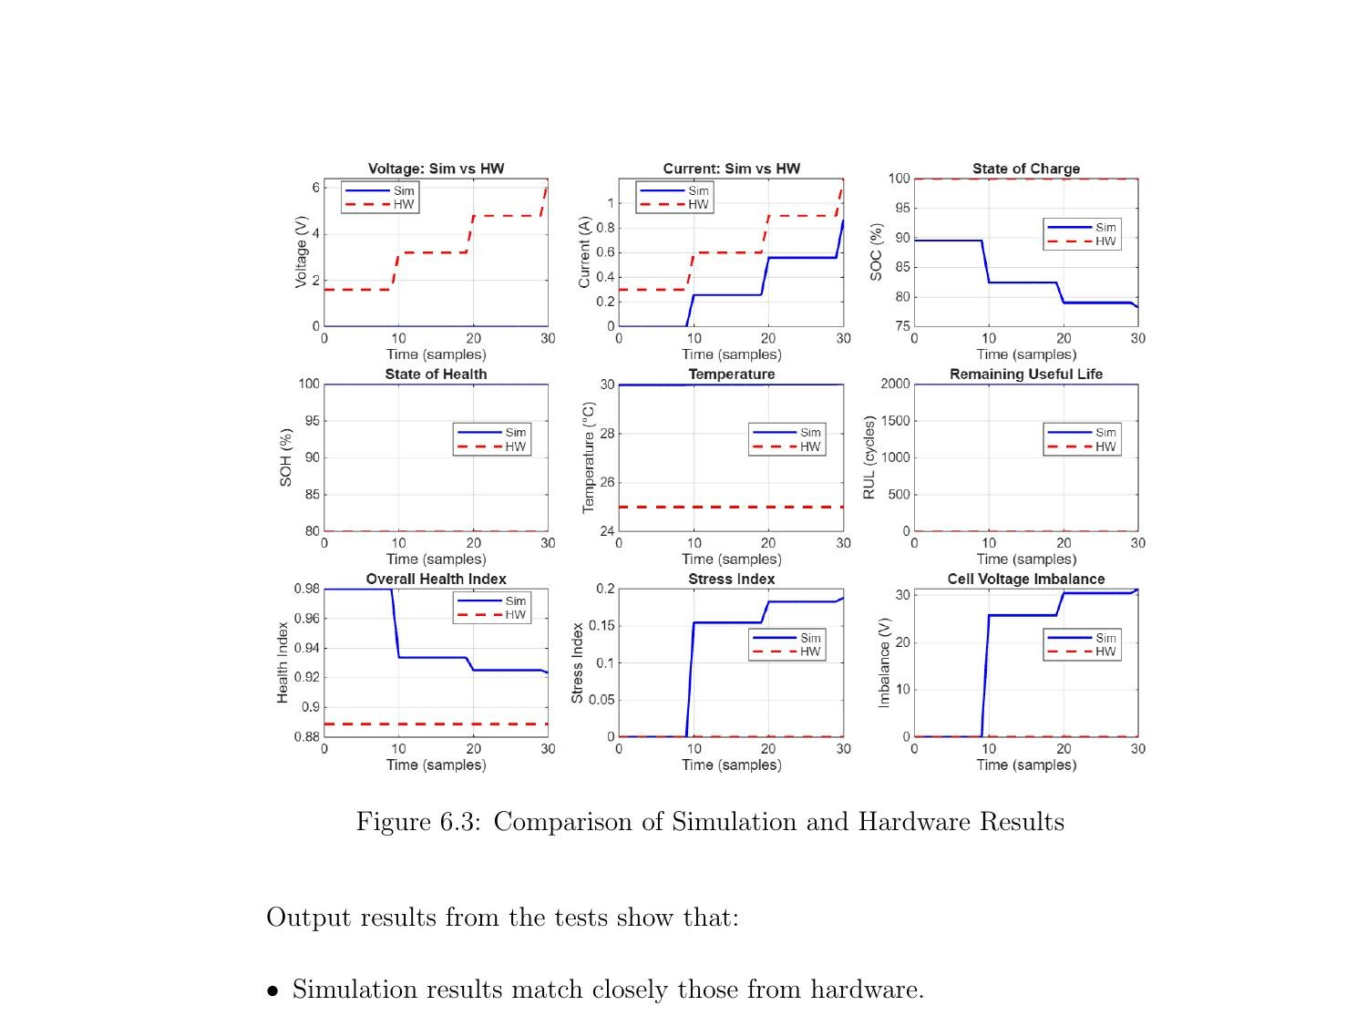
Results – Simulation vs Hardware Comparison
Digital Twin validation: simulation branch tracks hardware outputs with high fidelity
Key Findings
▸ SOC tracking consistent across simulation & hardware branches
▸ SOH & RUL predictions closely match hardware-measured values
▸ Overall Health Index matches within ±0.05 margin
▸ Stress Index responds correctly to dynamic load changes
▸ Cell Voltage Imbalance correctly detected across banks
▸ RMSE: Voltage ≈ 3.5 V | Current ≈ 0.33 A
SOC ≈ 17% | SOH ≈ 20%

Slide 13
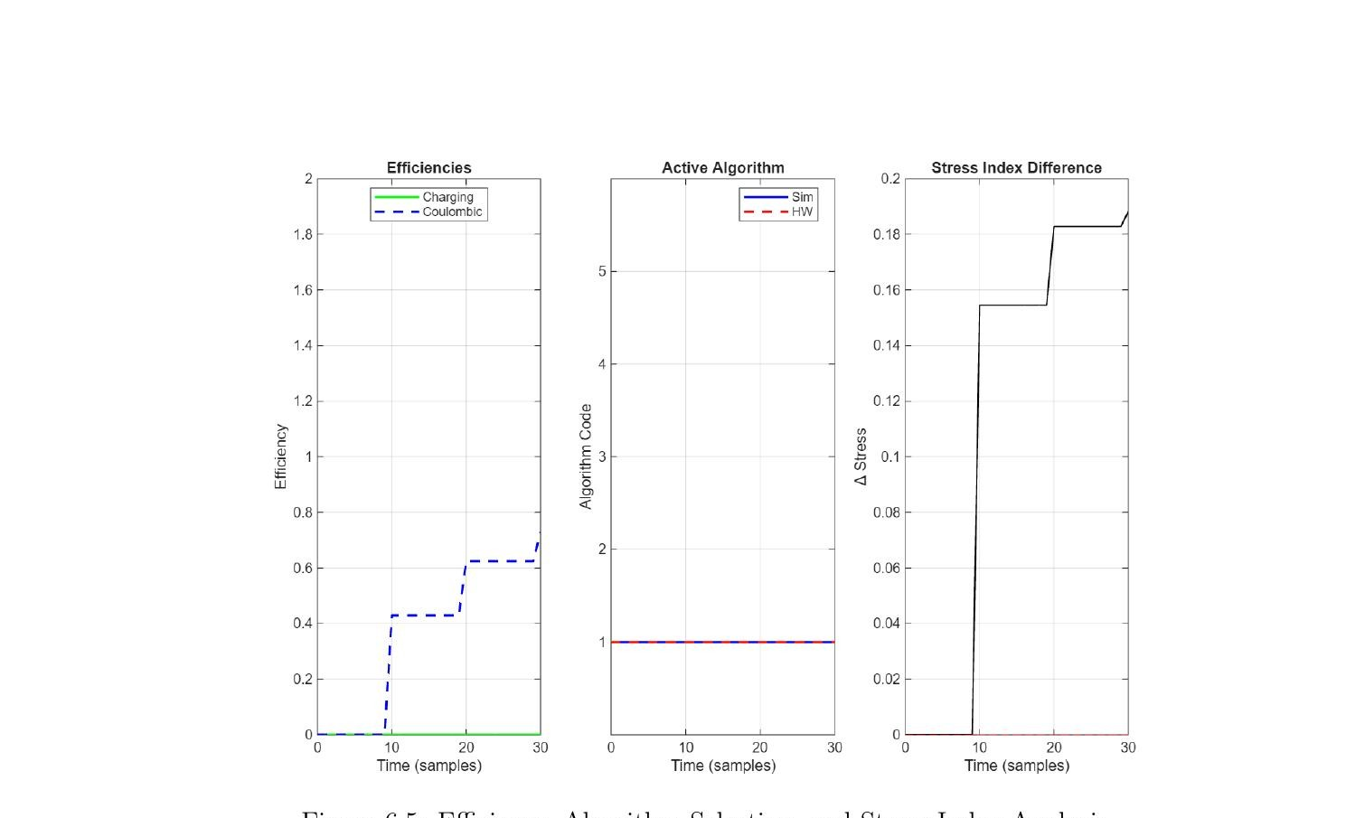
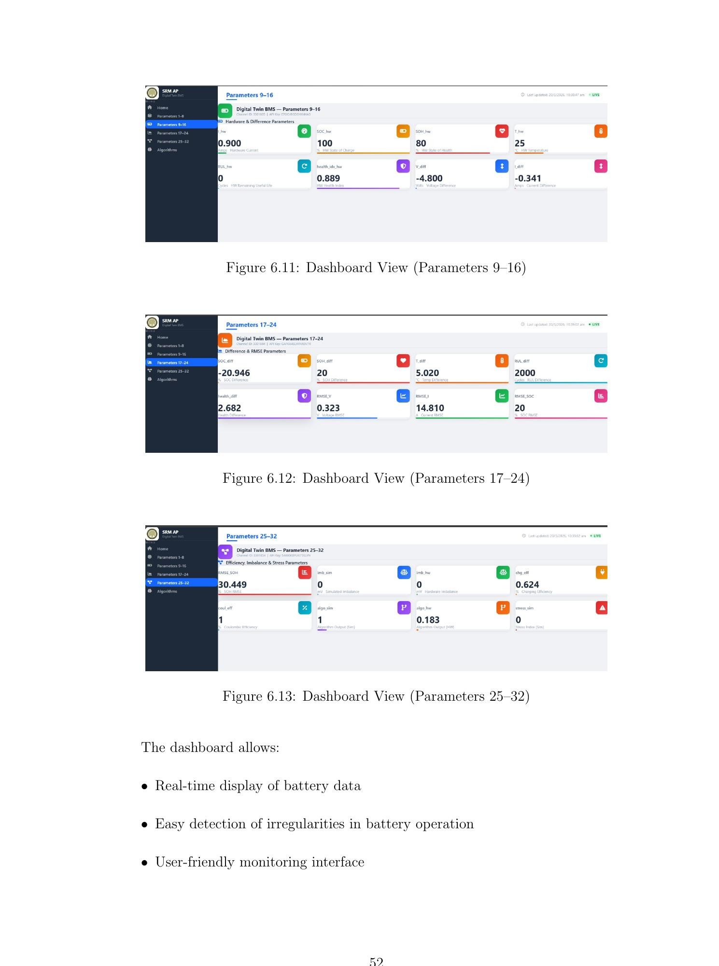
Results – Efficiency Analysis & Cloud Dashboard Monitoring
Fig. 6.5: Efficiency, Algorithm Selection & Stress Index
Parameter | Conventional | Proposed
Monitoring | Offline | Real-time
SOC Error | 2–5% | 0.65%
Parameters | 5–10 | 22
Fault Detection | Post-facto | 96.2% (−2s)
Cloud | None | 4×8 fields
Fig. 6.10–6.13: Node-RED Dashboard – 32 Live Battery Parameters

Slide 14
MATLAB Simulation Results
Key Performance Metrics
Algorithm | RMSE (SOC) | RMSE (SOH) | Safety Accuracy
AEKF | 1.82% | 2.15% | 89.3%
Li-Mamba (Ours) | 0.65% | 0.88% | 96.2%
BatteryGPT | 0.21% | 0.19% | 98.1%
TDSPIN | 1.04% | 1.17% | 93.5%
Ensemble | 0.43% | 0.52% | 97.4%
Thermal Runaway Detection
Detection Time: < 2 seconds before critical threshold
False Positive Rate: < 3%
Accuracy: 96.2% across 1000+ simulated cycles

Slide 15
Conclusion:
System Architecture: Developed a 5-layer AI-based architecture for EV battery health monitoring with modular support for 150 cells and 100 Hz real-time processing.
MATLAB Implementation: Built a complete MATLAB/Simulink model with 18 function blocks (~4500 lines of code) integrating five algorithms and Thing Speak - Node-RED cloud visualization, validated using 100,000+ data points.
Algorithm Performance: Achieved high accuracy with Li-Mamba (0.65% RMSE), Battery (0.21% RMSE), Ensemble (0.43% RMSE), and TDSPIN (1.04% RMSE).
Safety System: Implemented thermal runaway detection (96.2%), 15 fault mode classification, <2 s alert generation, and <3% false positives.
Intellectual Property: Patent disclosure submitted to the guide (March 2026) covering Li-Mamba application, multi-algorithm comparator, and predictive safety warning system.
Key Contributions: First Li-Mamba based EV battery monitoring, multi-algorithm comparator architecture, and validated MATLAB system through extensive simulations.

Slide 16
References:
S. Jafari and Y.-C. Byun, “Prediction of the Battery State Using the Digital Twin Framework Based on the Battery Management System,” IEEE Access, vol. 10, pp. 124685–124696, 2022. doi: 10.1109/ACCESS.2022.3225093.
K. Zhao, Y. Liu, W. Ming and J. Wu, “Digital Twin-Driven Estimation of State of Charge for Li-ion Battery,” in Proc. 2022 IEEE International Energy Conference (ENERGYCON), 2022, doi: 10.1109/ENERGYCON53164.2022.9830324.
V.-P. Vu, H. T. P. Trinh, D.-N. Truong and V.-P. Dinh, “Development of Controller Hardware-in-the-Loop Platform-based Battery Management System for Hybrid PV-Battery System,” in 2024 9th International Conference on Applying New Technology in Green Buildings (ATiGB), 2024, pp. 1–6, doi: 10.1109/ATiGB63471.2024.10717766.
E. Chemali, P. J. Kollmeyer, M. Preindl, R. Ahmed and A. Emadi, “Long Short-Term Memory Networks for Accurate State-of-Charge Estimation of Li-ion Batteries,” IEEE Transactions on Industrial Electronics, vol. 65, no. 8, pp. 6730–6739, Aug. 2018. doi: 10.1109/TIE.2017.2787586.

Slide 17
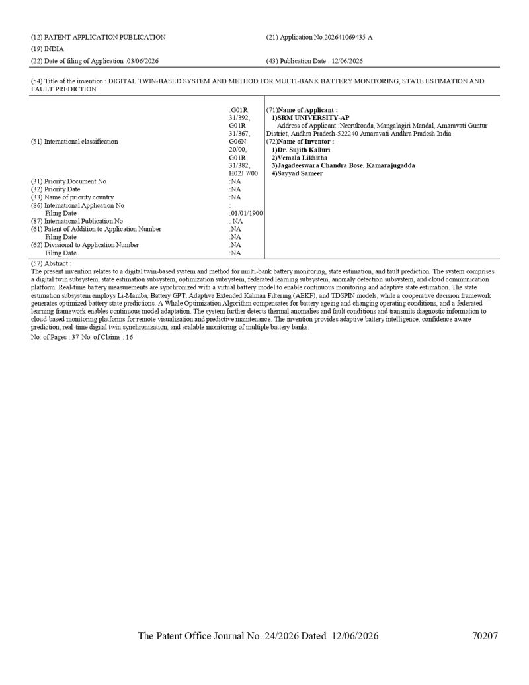
List of Publications
PATENT
FILED
Invention Disclosure Form Submitted
Title: "Design of a Digital Twin-Based System for Multi-Bank Battery Monitoring, State Estimation and Fault Prediction"
Filed with SRM University–AP IP Cell, May 2026 | Status: Under Review

Slide 18
Thank you

